Slide 1
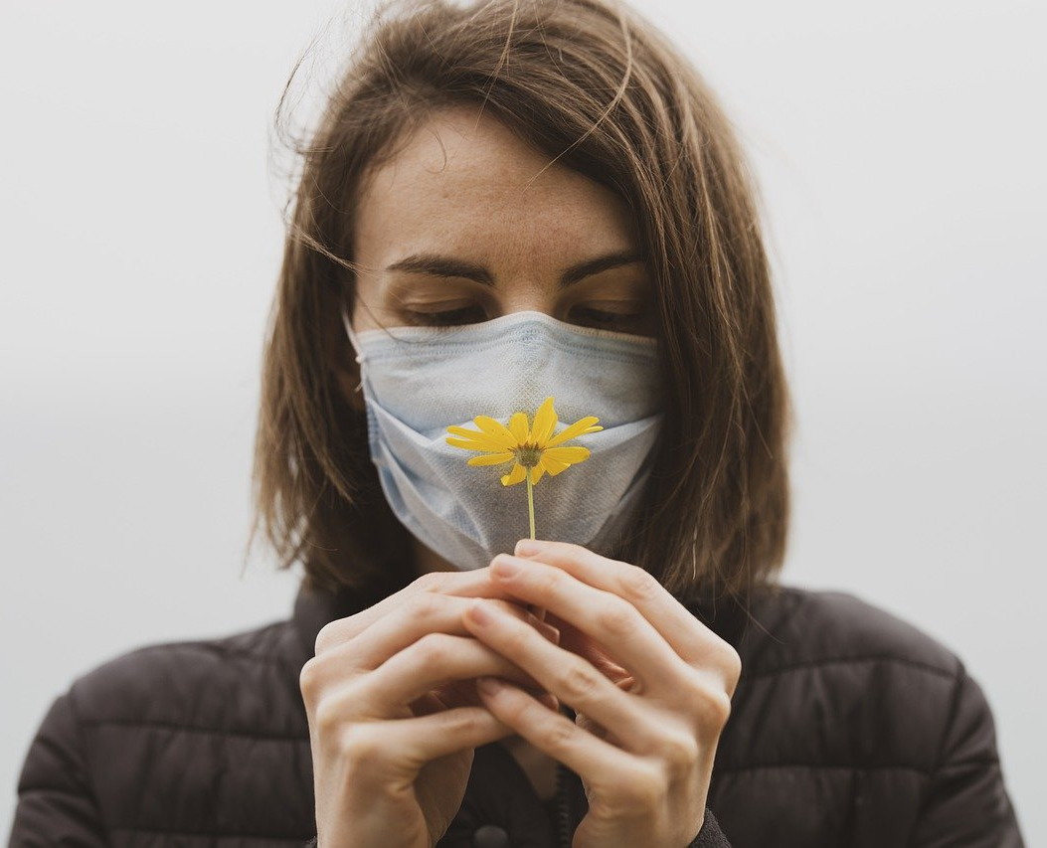
SAFEX
Your Safety Our Priority

Slide 2
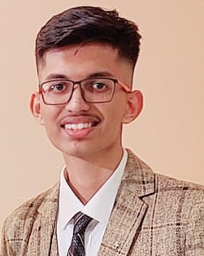
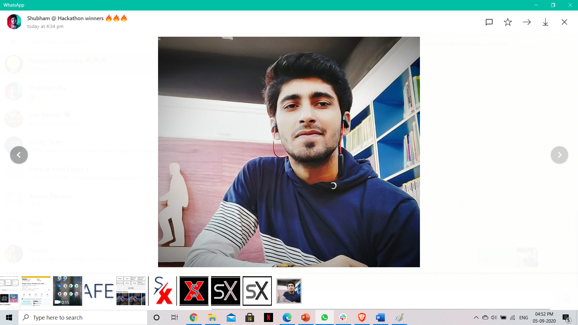
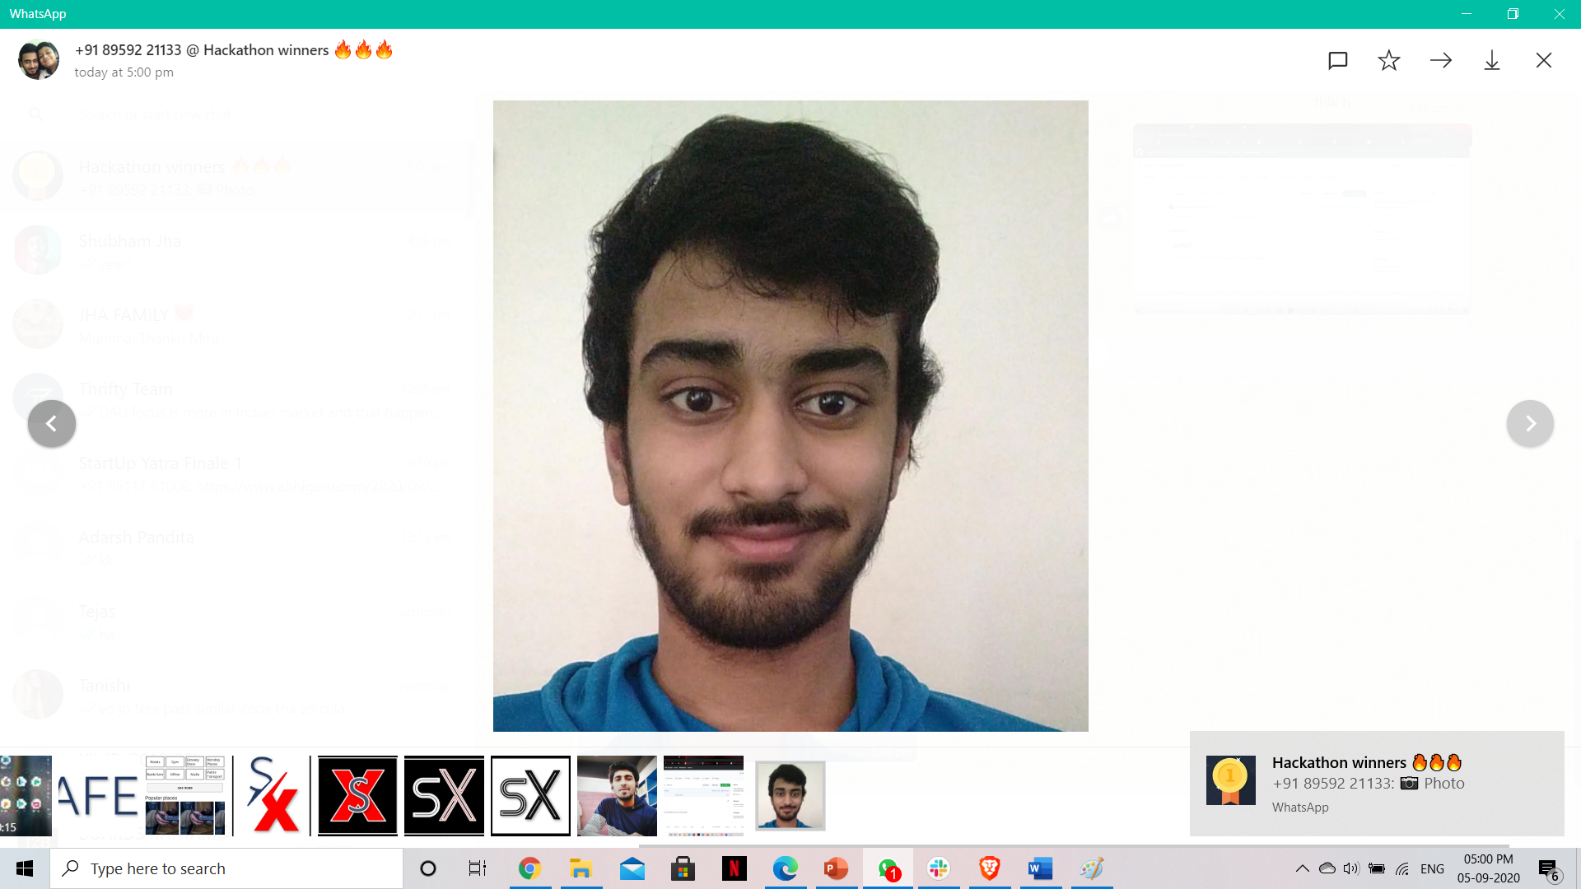

OUR
TEAM
Harsh
Jha
Shubham
Jha
Harshal
Sanghvi
AI Developer
Backend and Arduino
expert
Web Developer

Slide 3

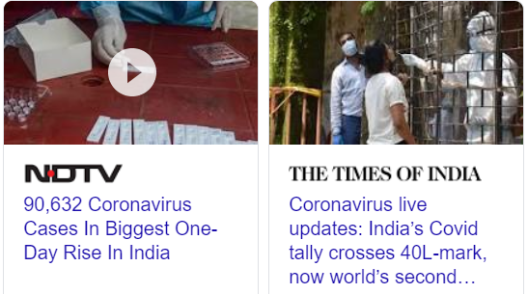
Problem Statement
During Lockdown, We all got stuck in our homes
After a long wait……
Finally Unlock process has begun all across the nation.
Malls , Cafes, Restaurants are finally opening back slowly-slowly.
.
But,
Coronavirus is still there and rising fast.
So how do we decide where should we go?
So which restaurant or Gym is safer?
Does that café follows proper Covid SOPs?

Slide 4
So many insecurities and we don’t know where to find answers?
How to decide which place is Covid19 Safe??

Slide 5

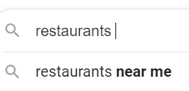
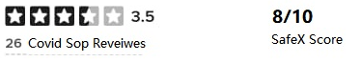
Solution
Presenting SafeX App and AI Software
An app that helps you check how Covid safe is a public place before visiting that place.
SafeX App comes with AI score based review/ratings feature where:
You search Public Places
Check ratings given by various users and our AI based on multiple factors
Decide the safest place to visit and enjoy
Just 3 easy steps
For visiting public places without risk of getting infected in Post Lockdown world

Slide 6
How does this system works
Based on collected data Ai generates score card
Personal AI Software
With CCTV
Hotels, Malls, Restaurants, Gyms, Public transport, Salons, Grocery Stores, Banks/ATM, Gas station, Pharmacy, Parks and outdoor spaces
Public Places
Recognize Staff wearing mask
Public Wearing mask
Social distancing Check
Facial Recognition to allow authorized people
Data of public places by user survey with reviews and ratings based on:
Regular Sanitization
Hygiene
Practicing Social distancing
SOP Followed by employees
Good ventilation
Digital menu? Disposable(For hotels)
Size of gathering
USER
SAFEX
App
Access to
collected data
Ai Generated score with user review data tells how safe is that place

Slide 7
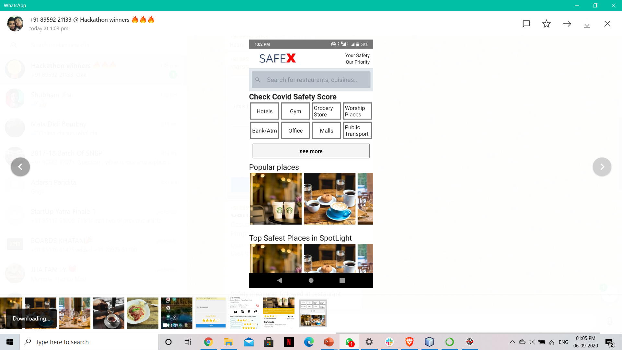
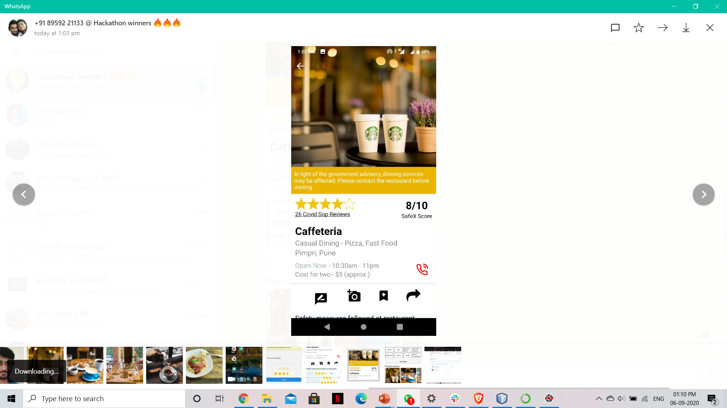
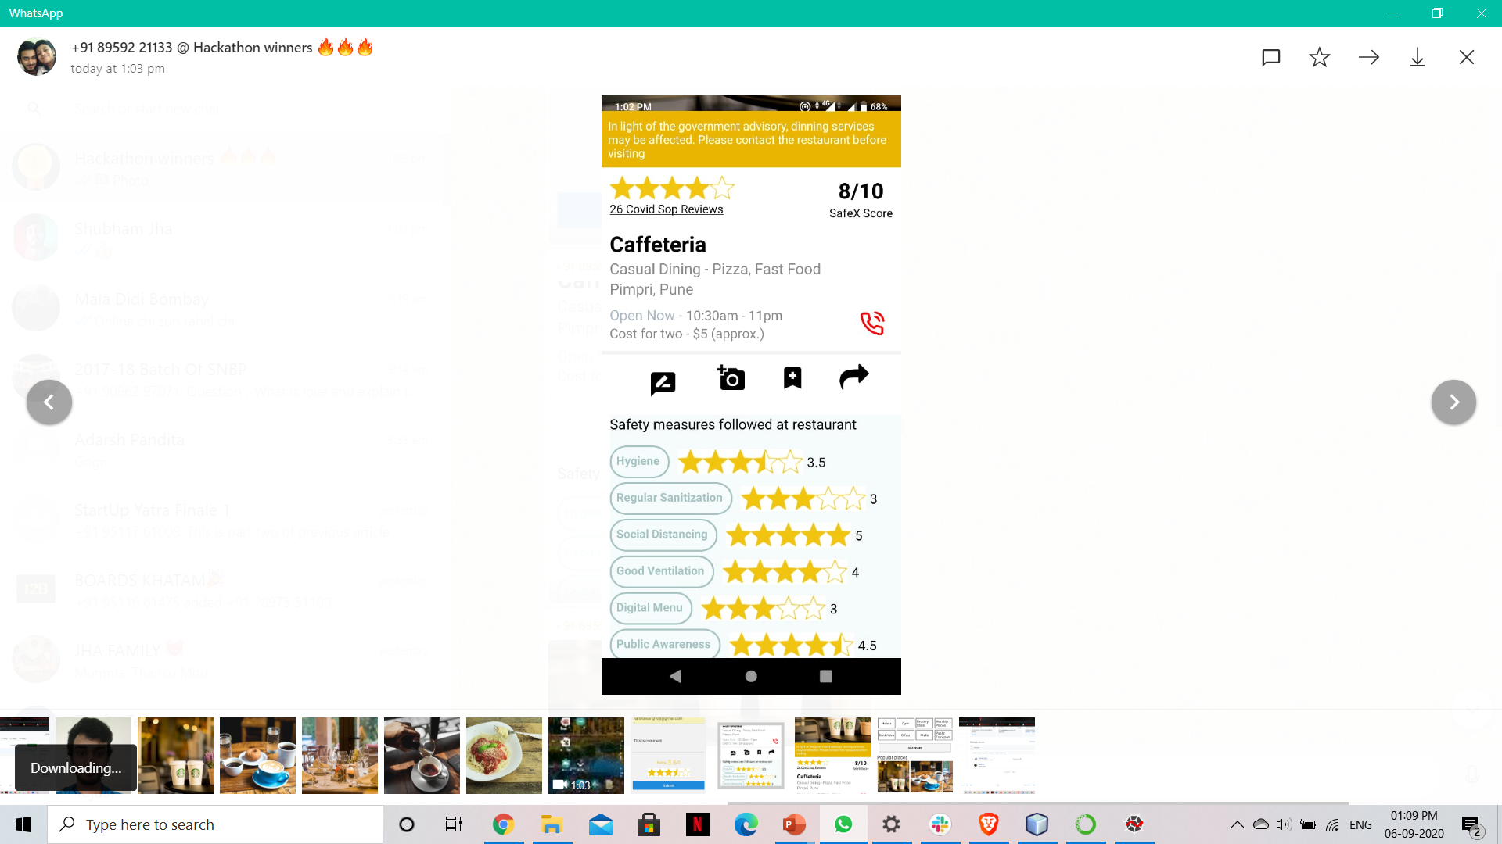
SafeX App (for Users)
Decide
and
visit that place
With
guaranteed
safety
Open home page and search for your desired public place
Check the overall SafeX score
You can also view the detailed ratings

Slide 8
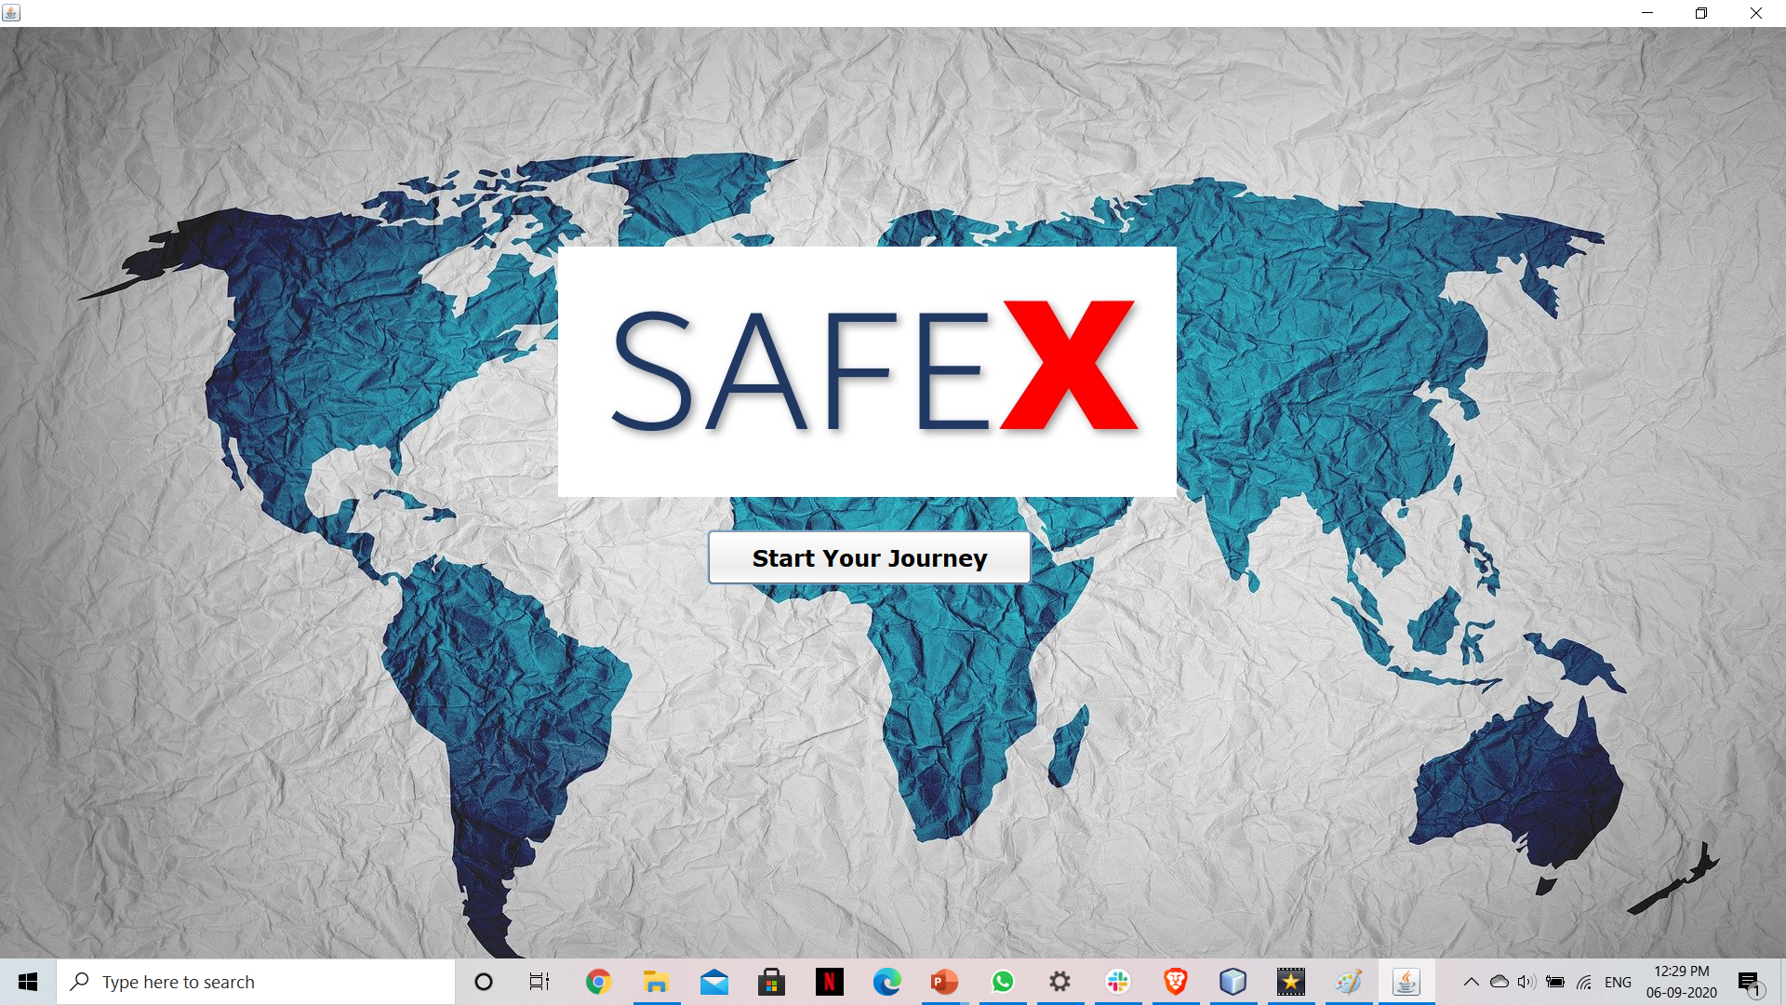
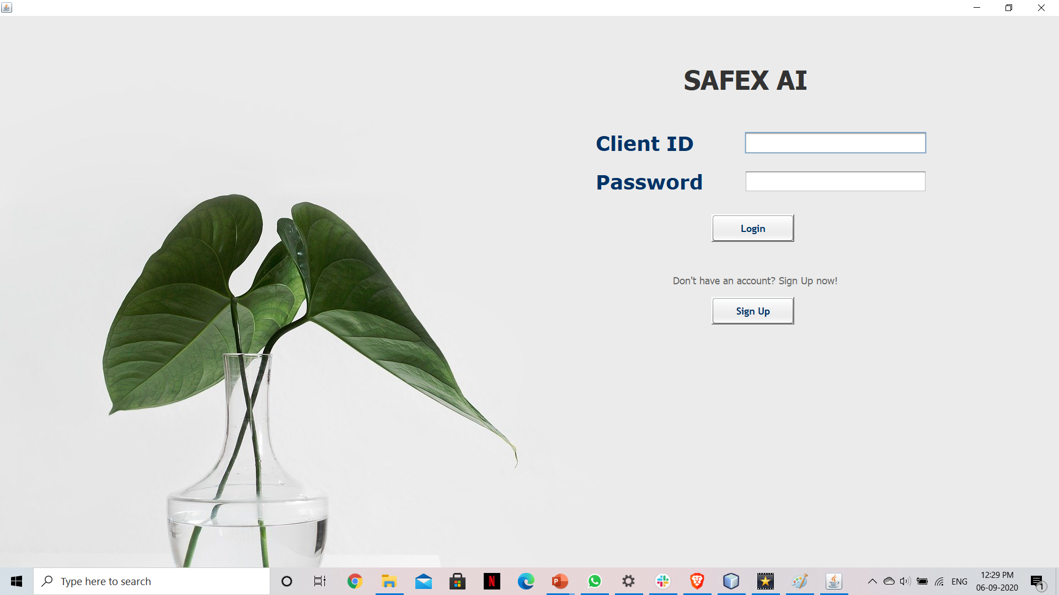
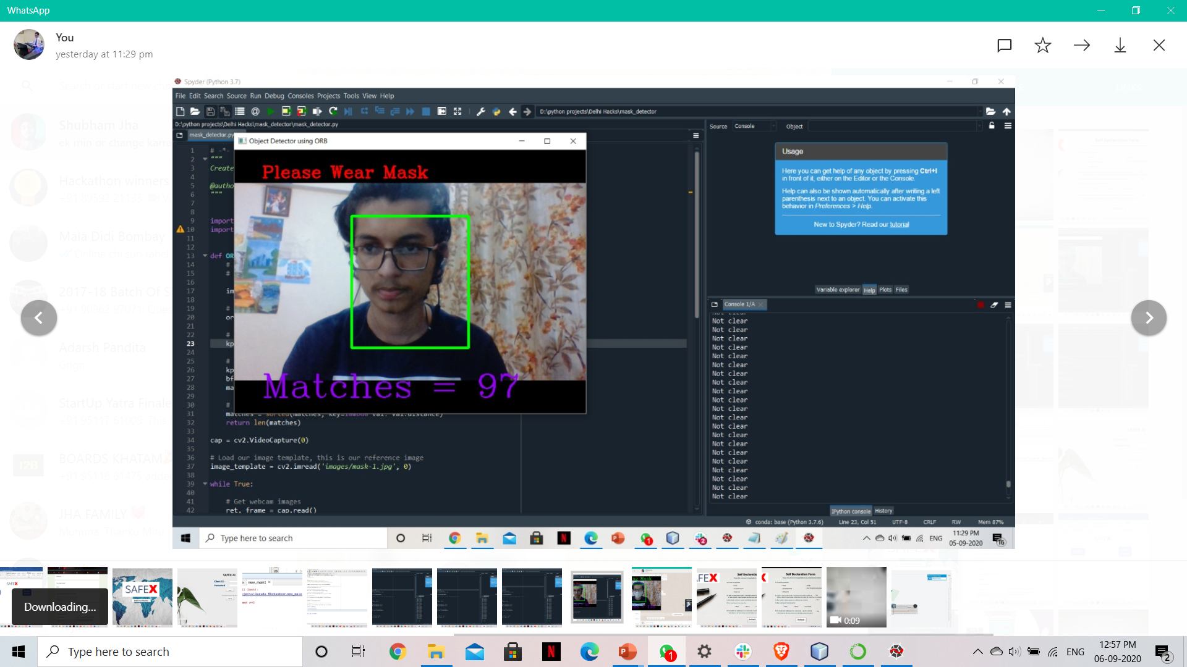
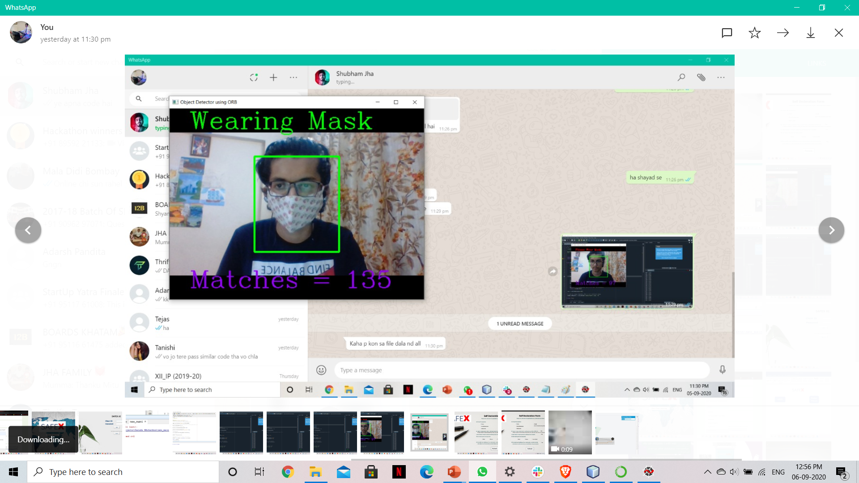
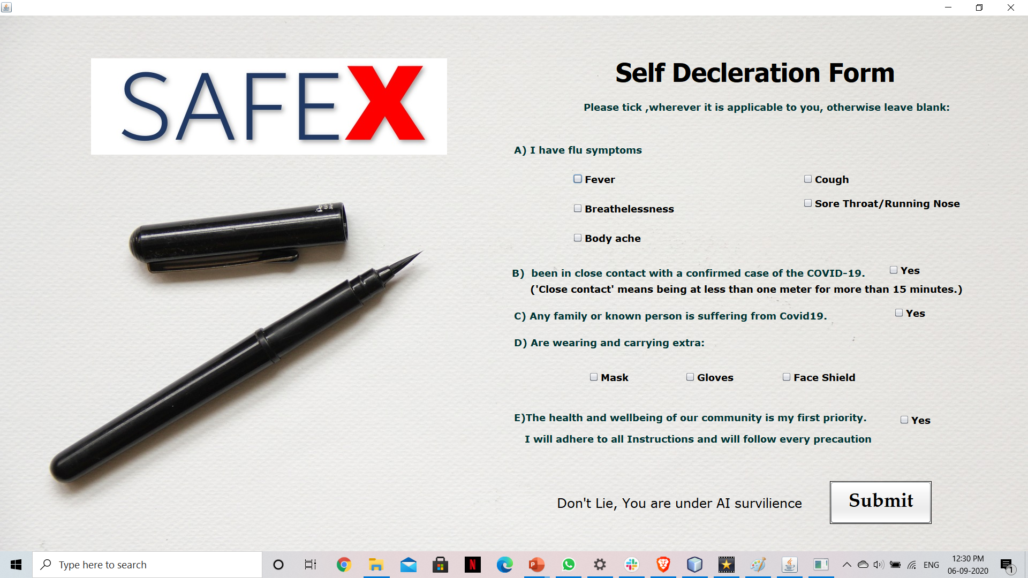
SafeX AI Software (for Business owners)
The trained AI for mask detection blends easily into the CCTV and collect's data.
Based on collected data, safety score is generated which is displayed in the app.
Any rule break leads losing score thus also reducing chances of that store to get placed higher in SEO, resulting in loss of potential customers for that shop.
So AI monitors and ensures that Covid SOPs are followed properly to ensure everyone’s safety

Slide 9
Challenges Faced
Training Ai in a such a short period of time was the greatest challenge. Though we overcame it with a juggad.
Designing App and integrating with database got us into some errors.
Collecting dataset for training AI was another challenge so we did a jugaad their as well
App integration and AI construction cost a lot of time

Slide 10
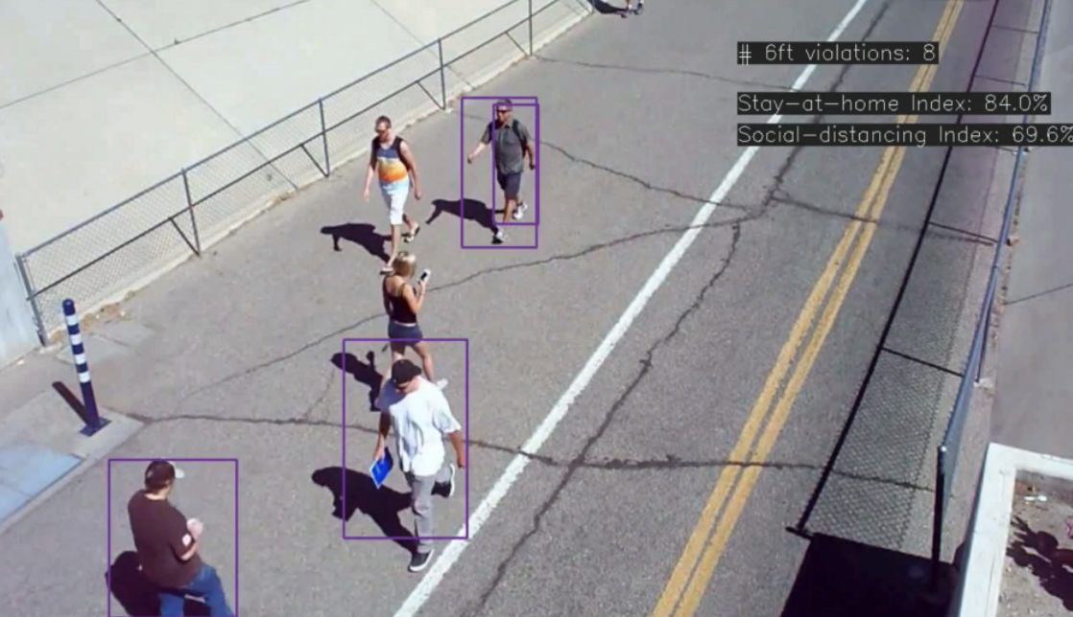
Milestones And Future plans
Completed
Future goals
App for user to check covid safety ratings.
Train AI for real time mask detection
Software for AI to keep check on staff and integrate data with app
-Add AI based Social Distance detecting method
-Time filter to check peak hours and real time violation alerts

Slide 11
Our Market
Potential Customers and users
SafeX App and Software
A real time Ai based app that helps user select covid safe place to visit
User
Business Owners
Normal People who are tired of staying, want to get their life back to normal but all concerned about their health will be our prime customers
The business owners who want to bring their customers back with trust that their business is safe and they follow proper SOP and procedures which is verified by an AI.

Slide 12
Summary
In this 36 hr hackathon we tried to build an AI based real time software with an app.
The app helps the user to check how covid safe is a place before visiting that place thus reducing chances of getting infected
This was a fun experience. The short time limit forced us to push our limits, think of new less time consuming methods and build a product that can practically help a lot of people(especially travellers) in this pandemic.

Slide 13
Thank You
Team

